Slide 1
Unit 203: Electrical installations technology
Cooker circuits and diversity

Slide 2
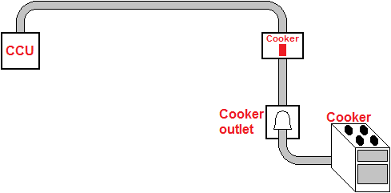
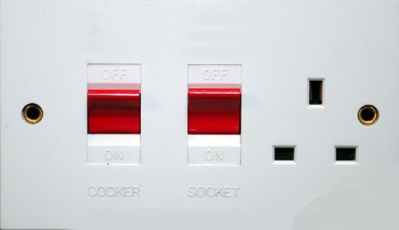
Cooker circuits

Slide 3
Cooker circuits
Example 1. Calculate the assumed demand for a 230 volt cooker which contains:
2 x 1.0kW hob plates
2 x 2.0kW hob plates
1 x 2.0kW oven/grill
1 x 3.0kW oven.
Maximum total power | =
 | = | kW
 | Maximum current | =
 |  | =
Maximum current | = | A

Slide 4
Cooker circuits
Example 1. Calculate the assumed demand for a 230 volt cooker which contains:
2 x 1.0kW hob plates
2 x 2.0kW hob plates
1 x 2.0kW oven/grill
1 x 3.0kW oven.
Maximum total power | = | (2 x 1) + (2 x 2) + 2 + 3
 | = | 11kW
 | Maximum current | = | P
 |  |  | V
 |  | = | 11 x 1,000
 |  |  | 230
Maximum current | = | 47.83A

Slide 5
Cooker circuits
The assumed current demand, allowing for diversity, is:
The first 10A at 100% | = | 10A
Leaving 37.83 at 30% | = | 11.35A
Total | = | 21.35A
This means that the cable supplying this cooker would have to have a rating of at least 21.35A. If the control unit contained a socket outlet then the rating would have to be at least 26.35A.

Slide 6
Unit 203: Electrical installations technology
The End

